Slide 1
Final Project
Veteran Analysis by
Fritz Knack, Stacey Hart, Ron Bingham

Slide 2

Veteran Analysis
We retrieved census data from Kaggle for 2015-2019 for the following:
Veteran population for US states including Race, Education, and Employment stats
Overall population for all citizens for the same date range
Latitude and Longitude of states for use in visulaization
The purpose of this project is to analyze the data for veteran population over a span of time compared to total population. Take this data set and put in a machine learning model to predict future enlistment for each state.

Slide 3
Resources/Tools
In this project we utilized Pandas, Jupyter Notebook, AWS, Postgres, and Tableau. We initially cleaned the data sets into usable pandas DataFrames and exported them to csv files. This data was then added to Postgres in order to join/merge the data to place into a machine learning model.

Slide 4
Code Samples
In the next few slides there are examples of code where the date was cleaned into usable DataFrames to easily be added to SQL tables in Postgres.

Slide 5
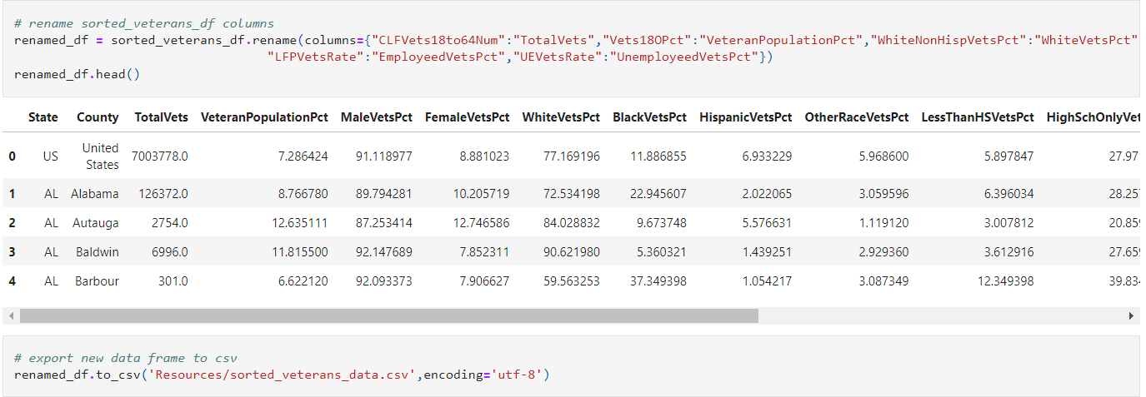
Code Example

Slide 6
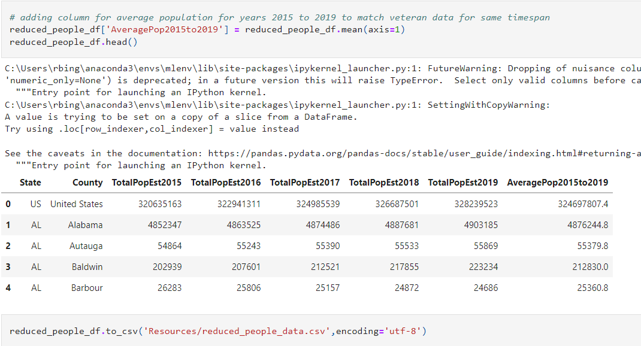
Code Example

Slide 7
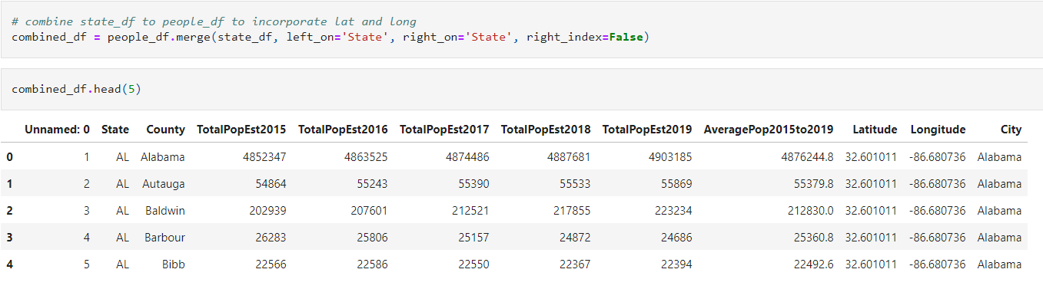
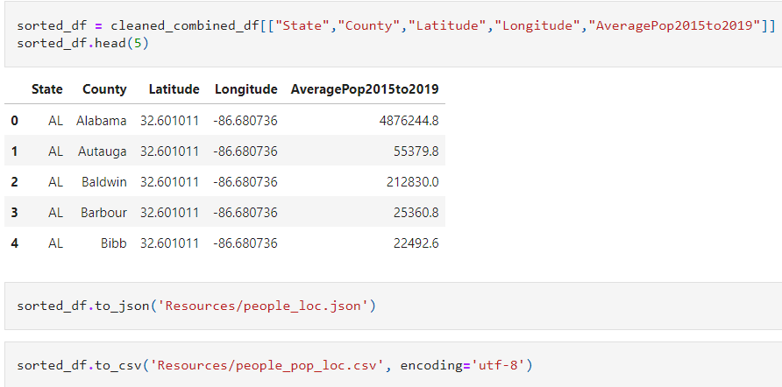
Code Example

Slide 8
Postgres (insert here)

Slide 9
Machine Learning (insert here)

Slide 10
Machine Learning Results (insert here)

Slide 11
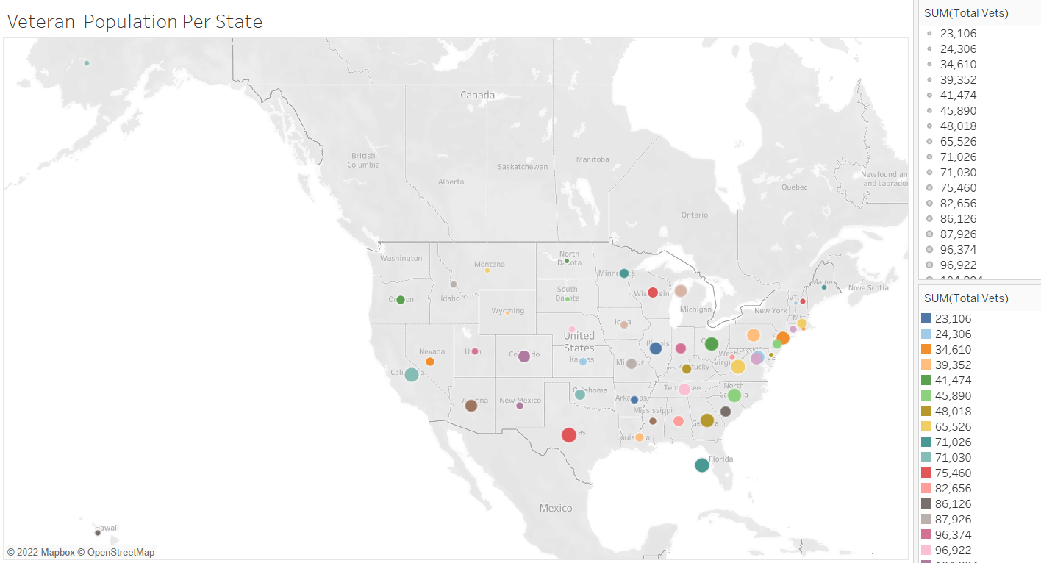
Visualization (insert here)

Slide 12
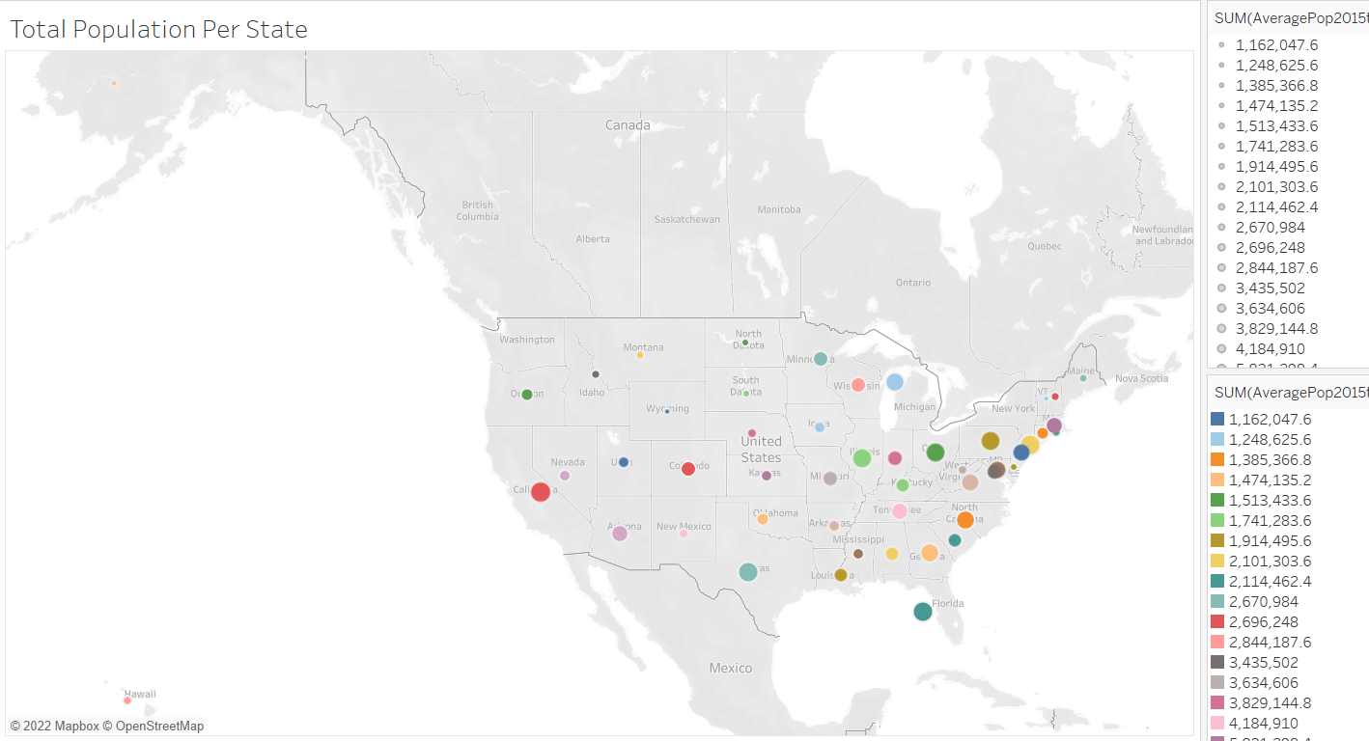
Visualization (cont.)

